Slide 1
The project “Drinking game”
Java_24_01
Kia Lapsina
Una Vilcane
Irina Nikitina

Slide 2
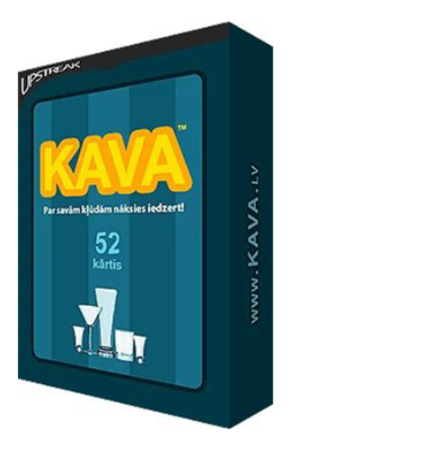
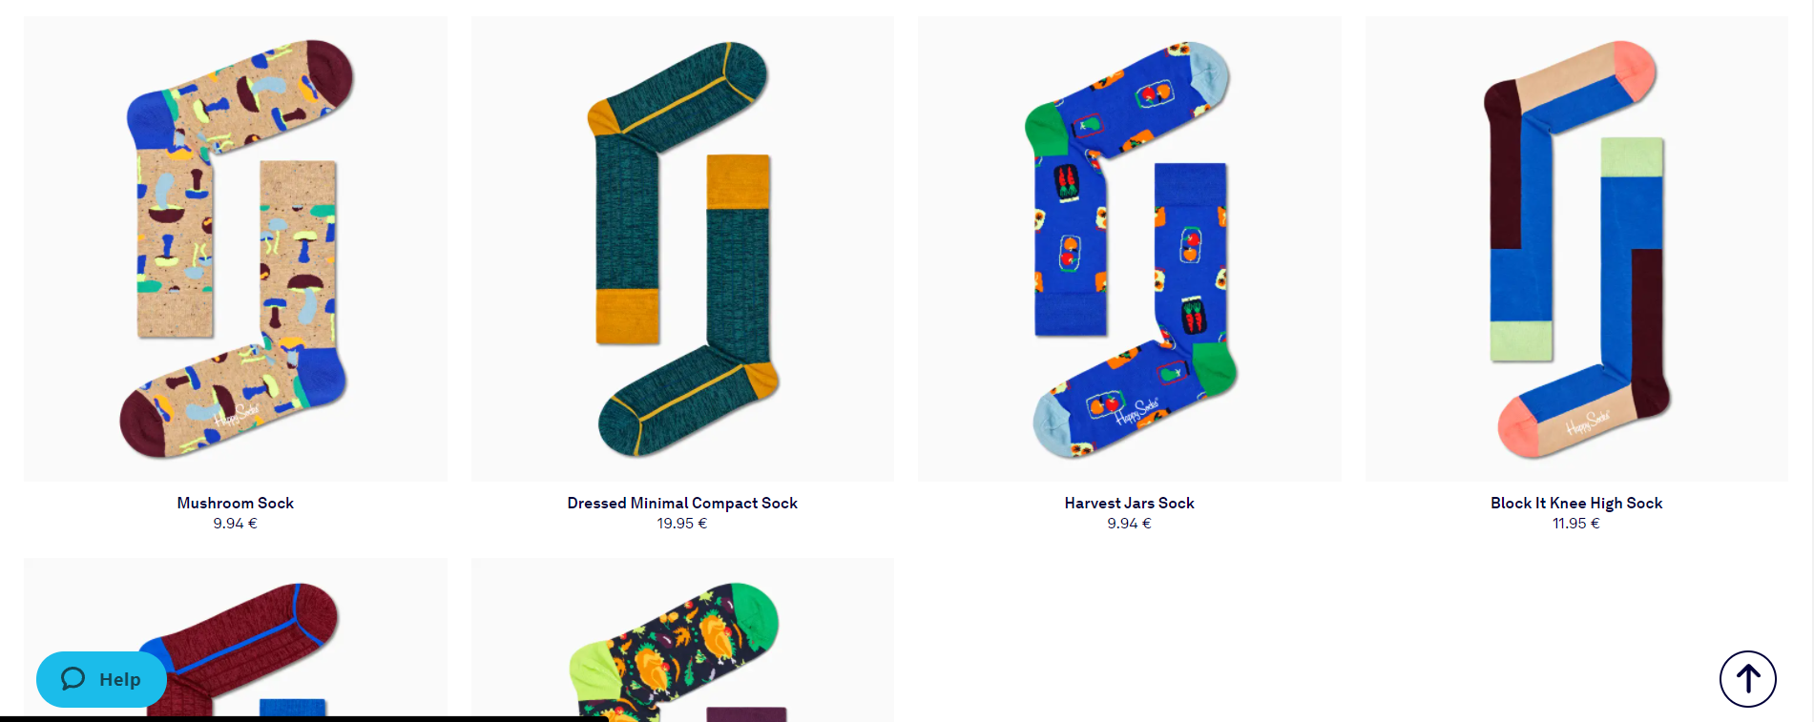
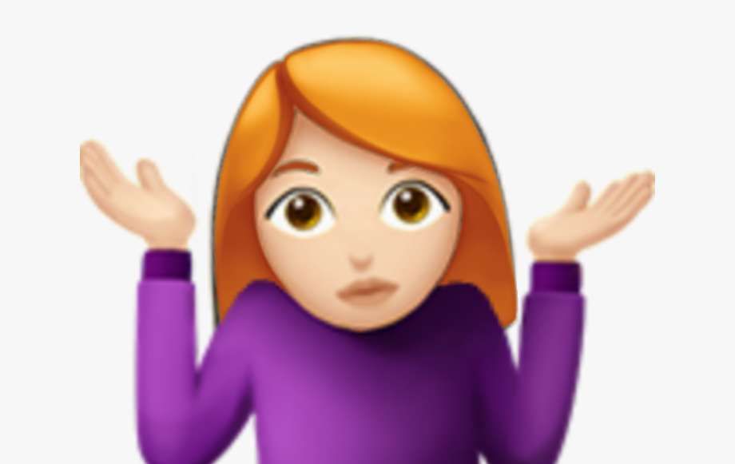
Idea
“The drinking game”
Online shop for the socks.

Slide 3
Rules
2 players
1 random number
Players by each turn counting the numbers starting from 1. But the number which contains or divides with the random cannot be displayed. The right numbers cannot be skipped. If the player says the “wrong” number or skips the "right one", he drinks, and the counting continues till one of the players drank 5 times. Then the player counts as “fully drunk” and the opposite player wins.

Slide 4
Roles
Irina - outside game coding, GitHub guru
Kia - in the game logic coding
Una - database guru
We all – checking and fixing mistakes, support each other

Slide 5
Process of project
Trello board tasks
Photoshop sketches
codeshare.io sharing codes
Zoom meetings
Zoom codewriting/sharing -> Zoom (sketches) -> codewriting/sharing -> struggling -> Zoom -> asking for help -> Zoom -> codewriting/sharing -> Zoom (struggling) -> codewriting/sharing -> Zoom -> asking for help -> codewriting/sharing

Slide 6
Schema
Player class
Main
MSQL Database
Database class

Slide 7
Schema + methods
Get name
Get number
Get mistakes
Add mistakes
Player class
Main
Making array
Checking if number contains random
MSQL Database
Database class
Insert data
Read data

Slide 8
Process of making a game
Array
Players
Who drinks
Database

Slide 9
Thank you!

